Slide 1







Cornell Tech & Samsung
Team BlueMoon
Jiacheng Dong
ORIE
James Chen
ORIE
Christian Rodriguez
CS
Mansi Garg
MBA
Harry Li
ORIE
Frans Fourie
ECE
Alan Abraham
MBA
Notes:
Good day we are team Blue moon and this is our sprint 3 presentation

Slide 2
The more you cook, the healthier you live. - Public Health Nutrition
Cooking expands your intake of healthy foods. - Harvard Health
Notes:
When looking at studies, headlines like these are common place
FJ - 1 min
Harry -
James - 40 s
Christian -

Slide 3
How might we improve the cooking experience?
Notes:
Beacuse of this we decided to focus our how might we on improving the home cooking experience getting people to cook more

Slide 4




Meet Samantha
Pain Points
I want personalized recipe recommendations to suit my family’s health needs
I would also like to avoid food wastage but I keep forgetting about items.
I generally plan a week before to budget my groceries.
Female
36 years old
Software Engineer
Lives in New York
Notes:
Based on our user interviews and survey stats, we came up with our user persona. Let’s meet Samantha, a 36-year-old software engineer who lives in New York with her husband. We have identified three most important pain points for her, which are personalized recipe recommendations to suit the family’s health needs , avoiding food wastage and weekly meal planning.

Slide 5
Samsung Fridge Assistant
A recipe recommendation app that suggests recipes based on the ingredients in your fridge, your user profile and preferences.
User asks for recipe recommendation
Fridge sees what is inside
Suggests recipes
User selects recipe
User starts cooking
Notes:
How can we tackle these pain points leveraging Samsung’s existing technology?
From our discussion with the company advisor, the latest Samsung smart fridges are equipped with built-in camera and computer vision algorithms which can effectively detect what is in the fridge.
We want to bring this user experience one step further and introduce to you the Samsung Fridge Assistant, a smart application that provides customized recipe recommendations based on the items in your fridge and your personal preferences.

Slide 6
Success metric
How pleased are our customers with their cooking experience?
Notes:
To evaluate the success of this product, we have designed the following metric: How pleased are our customers with their cooking experience?

Slide 7
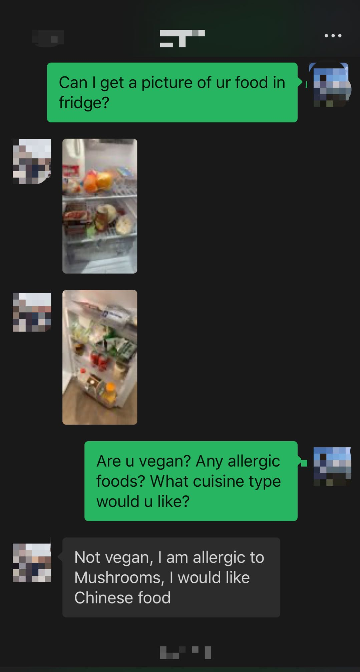
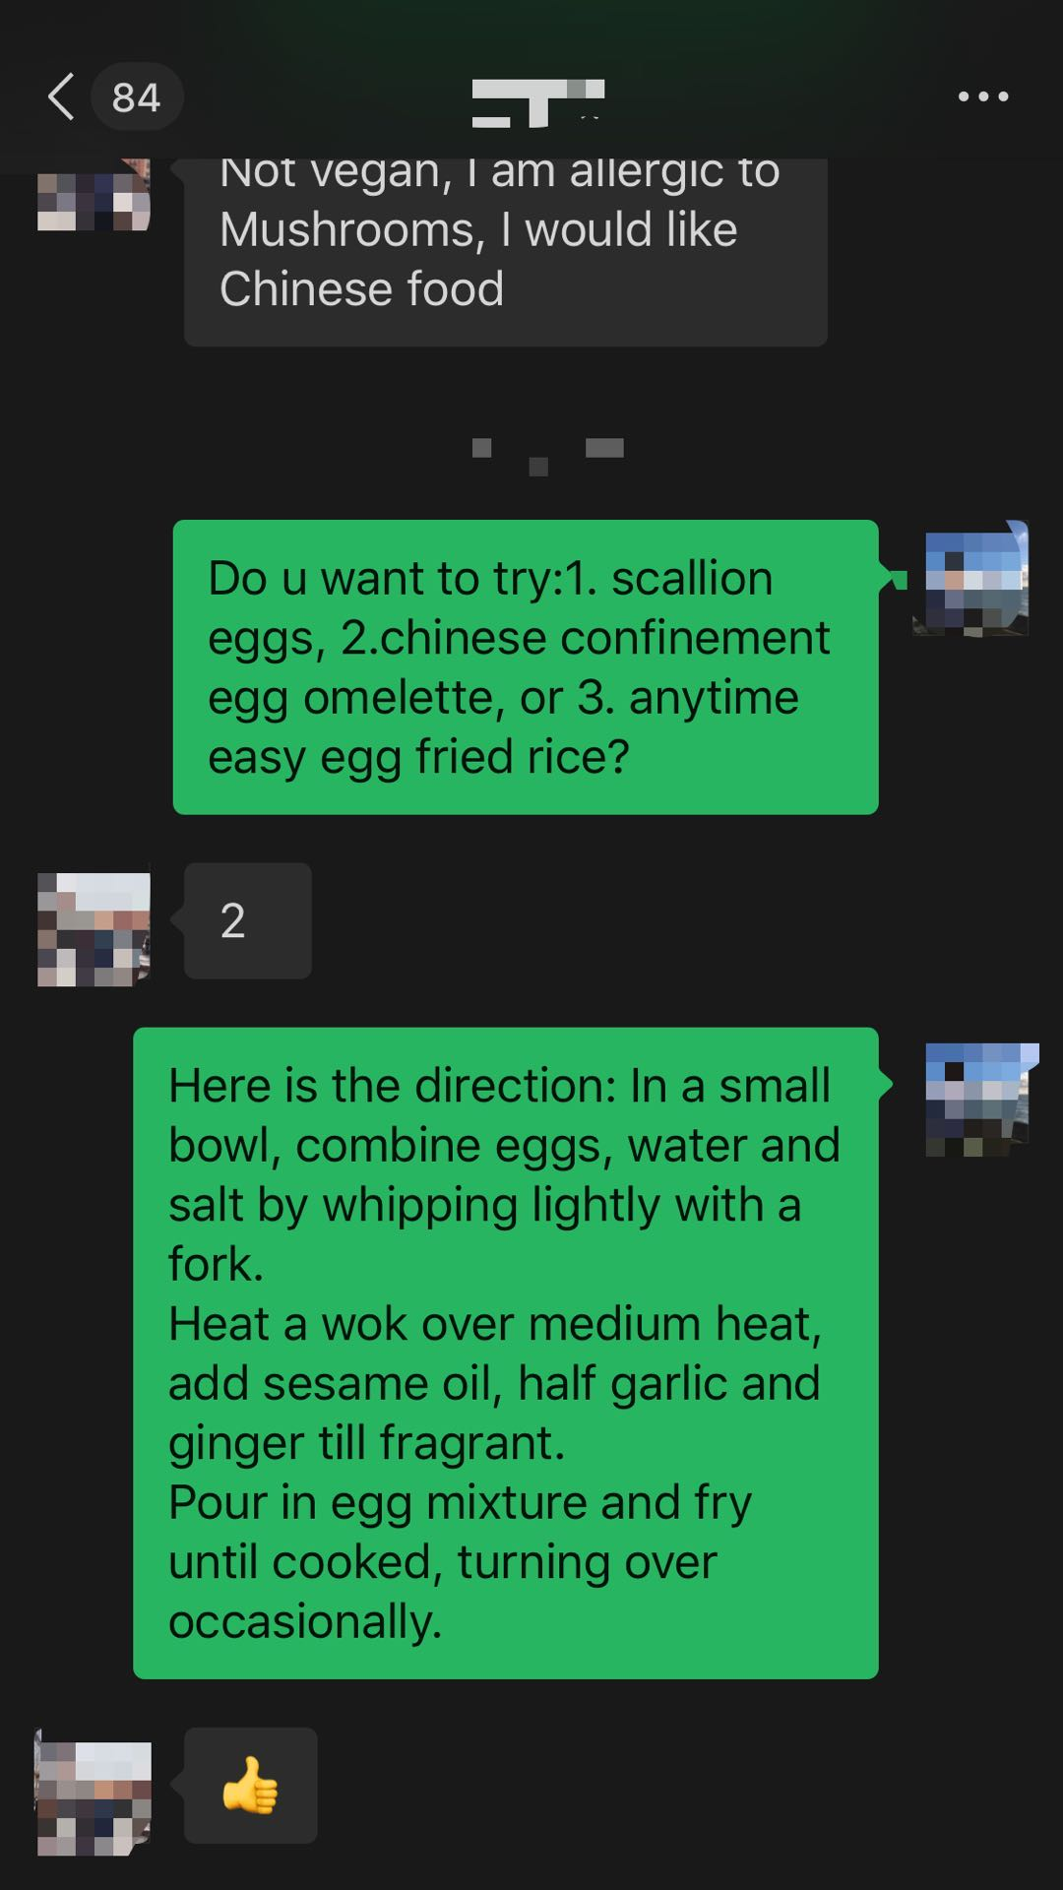
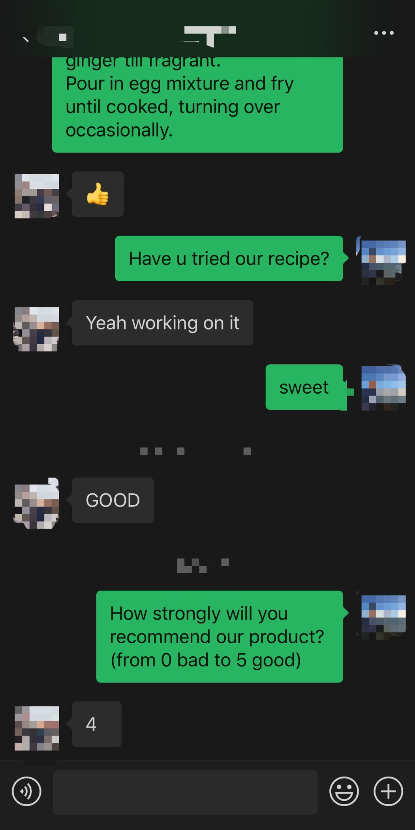
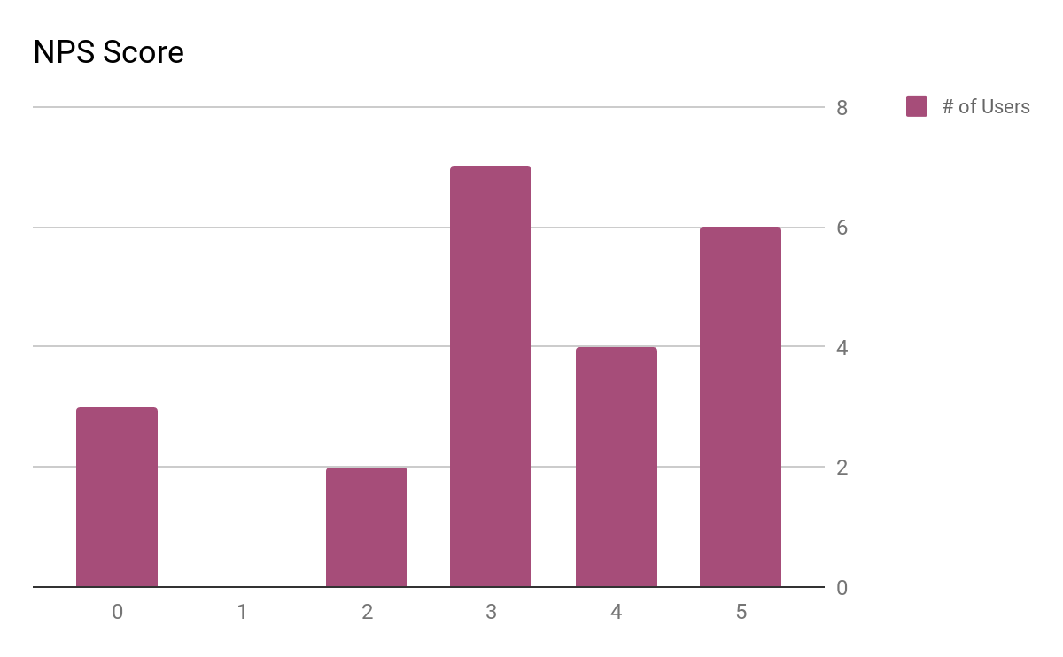
Validation
Take Pic
Text Recipe
Receive Feedback
Notes:
To validate our product idea, we did some cheap experiments with people from various backgrounds. We asked them to take picture of their food in fridge, provide them with recipe recommendations in text, and then collect their feedback. From the NPS score chart, we can see that most of users in our test groups have had a positive review on our product.
NPS score - How strongly will you recommend our product?
6 - 11 - Harry

Slide 8

Demo ~ 30 seconds
Notes:
https://drive.google.com/file/d/1eGjB7tUs7df2z6bIoqcAHomeiuxJa_7e/view?usp=sharing

Slide 9
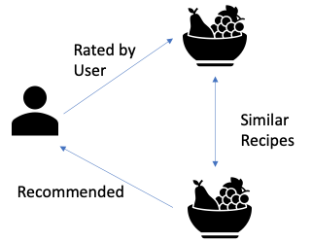
Recommender System
Diet preference, nutrition, cooking time filtering
Food availability function
Content-based recommendation system scoring
Notes:
Recommender team

Slide 10
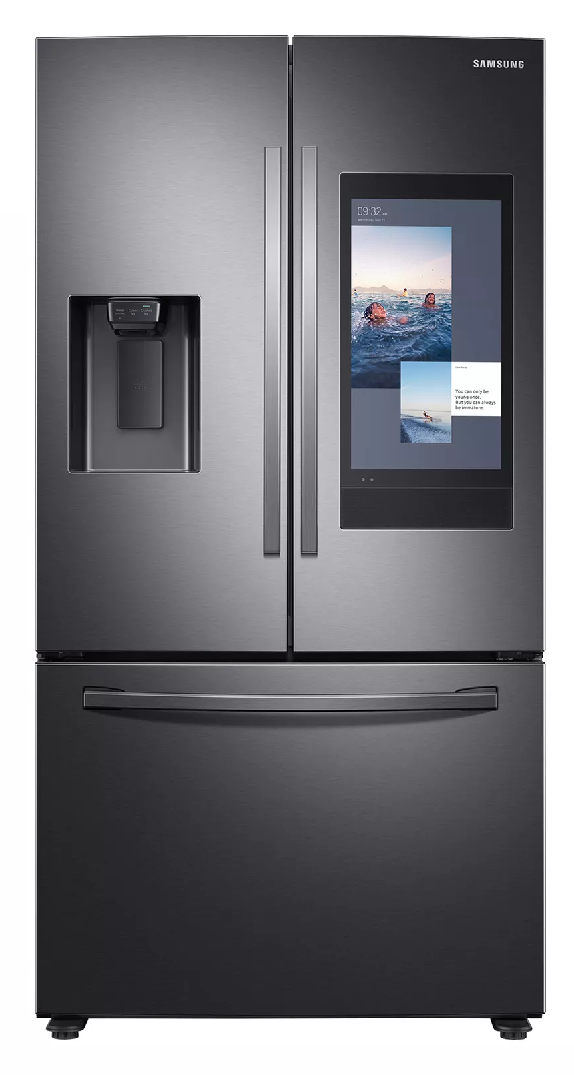
Next Steps
0. Validate
1. Integrate
2. Use real user data
3. Enhance UI/UX
Notes:
Alan
With data accumulation in the future(more ratings of user and more sample space), we will adopt collaborative filtering, user-based recommendation, additionally we will mine the association rule to recommmend recipe combination for user

Slide 11
Strategy
Samsung bought SmartThings (IoT)
Samsung has 22.3% of the Fridge Market
Notes:
Samsung has 22.3% of the fridge market. This means that first, they’re in a unique position to tackle this specific problem. Second, they will be able to charge a premium price on their high-end fridges initially.
Eventually trickle this down to mid-range fridges as well through economies of scale and differentiate the entire product line.
Future of IoT signals more connected things. Billions more. Much smarter. More immersive experiences using AR/VR, and more robotic automation. Maybe in the near future we will have AR glasses and our app will evolve to guide us step by step in the cooking. And maybe one day Samsung will have robotic arms which actually does the cooking for you. And in that case our product will tell it what it can cook! Either ways, this is a first step into the IoT ecosystem.

Slide 12
Thank you

Slide 13
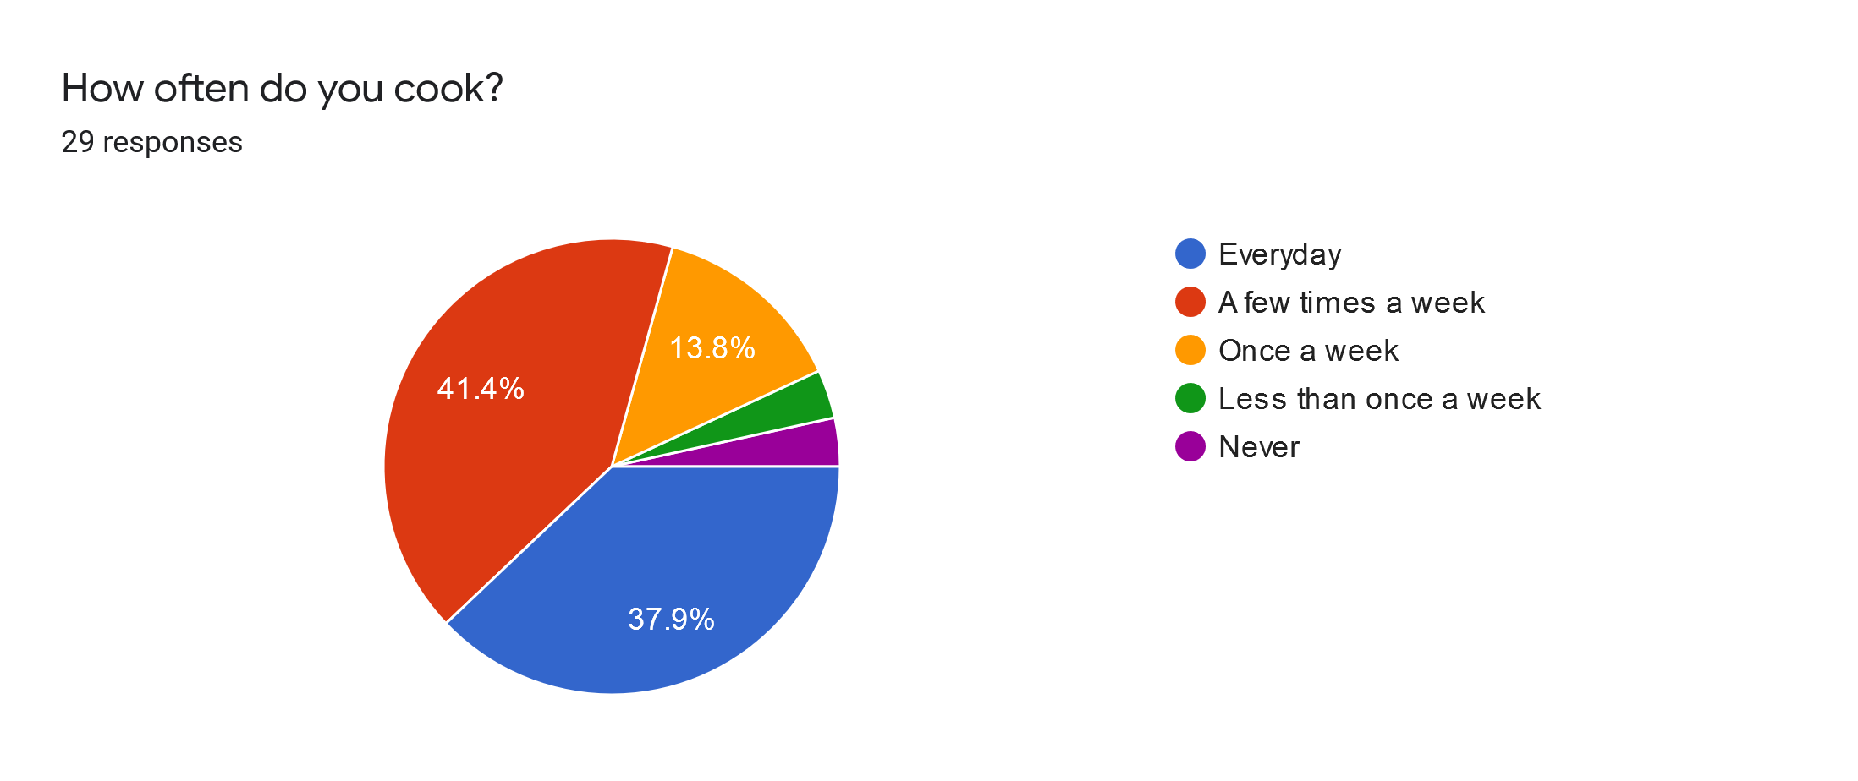
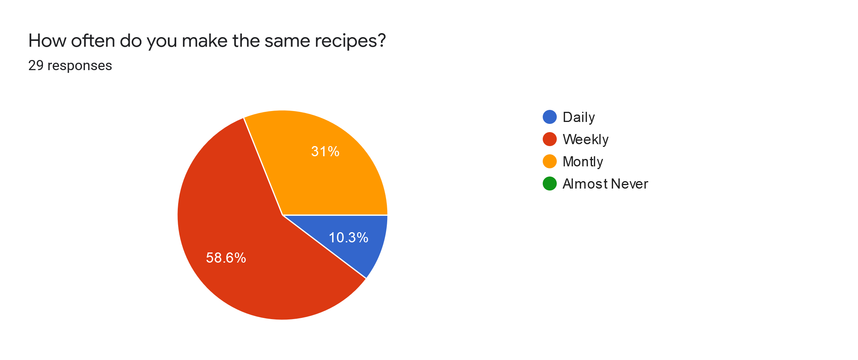
Survey stats
A large portion of people cook daily (37.9%)
Most people cook multiple times per week (79.3%)
Almost everyone cooks at least once per week (93.1%)
Most people cook the same recipe multiple times per week (68.9%)
Everyone that participated in the survey repeats recipes.
Notes:
Recommender team (FJ)
From our survey we got the results that most people cook very often and of these people almost all of them repeat recipes weekly thus we can give them access to new exciting recipes that match their dietary preferences allowing for larger variety in their cooking. This will increase the excitement people have about cooking at home.

Slide 14
What did Samantha teach us?

Slide 15
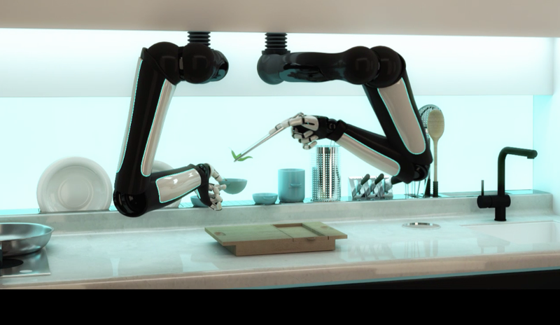
Vision
Notes:
Samsug has 30% of the fridge market. This means that first, they’re in a unique position to tackle this specific problem. Second, they will be able to charge a premium price on their high-end fridges initially.
Eventually trickle this down to mid-range fridges as well to differentiate the entire product line.
Future of IoT signals more connected things. Billions more. Much smarter. More immersive experiences using AR/VR, and more robotic automation. Our vision is that one day Samsung will have robotic arms which actually does the cooking for you. And our product will tell it what it can cook! This is the first step into the IoT ecosystem.
Christian - 14-16

Slide 16
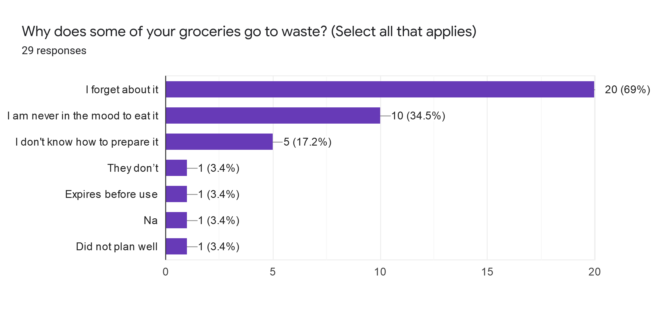
Problems Identified
In US, food waste is estimated at between 30-40 percent of the food supply.
The main reason people have food wastage is due to forgetting about it
The second most prominent reason is people not in the mood for the food
Notes:
Recommender team (FJ)
By conducting surveys we found that a lot of people struggle with food wastage due to forgetting about items, never being in the mood for items they bought or not knowing how to prepare certain items. Thus we set out so solve this problem by getting people to cook more and waste less.

